Slide 1
DIGITAL LOGIC CIRCUITS
Building blocks of Digital Computer
11/03/21
Computer Org & Arch

Slide 2
Digital Logic Gates
Modern digital computers are made using integrated circults.
It has thousands of electronic switches or transistors organized in form of logic gates.
- Consists of transistors that act as a switch capable of switching electronic signals On and off.
11/03/21
Computer Org & Arch

Slide 3
Logic Gates
Logic gates are transistor circuits and they are the basic building blocks for construction of a computing system. They serve as the "bricks" for designing a computer architecture.
-Every digital product like computers, mobile, calculators even digital watches contains logic gates.
11/03/21
Computer Org & Arch

Slide 4
Digital Logic gates
In the binary number system, there are only two possible values, 0 (off / false) and 1 (on / true).
The near absence of voltage to represent a 0 and the presence of substantial voltage to indicate a 1
11/03/21
Computer Org & Arch

Slide 5
Digital Logic gates
A simple logic gate takes two inputs (two electrical connections) and generates one output (one electrical connection).
Each input will either be on or off, meaning it carries voltage or does not.
The output will also be either on or off.
A particular gate performs the algebraic function that corresponds to it's name.
11/03/21
Computer Org & Arch

Slide 6
Logic gates
Each particular type of logic gate has a pre-determined set of possible input / output combinations.
This set of combinations is conveniently illustrated by what is called a truth table.
11/03/21
Computer Org & Arch

Slide 7
Truth Table
The best way to describe a logic system is by using what is called a Truth Table.
A truth table is a tabular layout which shows the relationship between the output from a logic circuit and all possible inputs to the circuit. Both outputs and inputs are expressed in terms of 0’s and 1’s
11/03/21
Computer Org & Arch

Slide 8
Logic Gate
Definitions
A digital circuit with one or more inputs, and an output which depends logically on the input signal combinations.
Gate: a computer circuit with several inputs but only one output that can be activated by particular combinations of inputs.
11/03/21
Computer Org & Arch

Slide 9
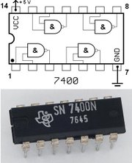
Chip
11/03/21
Computer Org & Arch

Slide 10
Diagram
The legs on the integrated circuits are used to feed the signals from the micro-miniature circuit inside the device to the outside world.
11/03/21
Computer Org & Arch

Slide 11
Logic gate
A few basic types of gate are needed to build digital circuits
There are seven basic logic gates: AND, OR, XOR, NOT, NAND, NOR, and XNOR.
Each gate performing a particular logic function
11/03/21
Computer Org & Arch

Slide 12

AND Gate
An AND function is implemented electrically using a device known as an AND gate.
Circuit symbol and logic combinations
The AND gate derives its name from the fact that we get an output of "true" when both inputs are "true." Otherwise, the output is "false." X = A.B
A AND B= A.B ( Symbol of AND gate is denoted by ‘.’
11/03/21
Computer Org & Arch

Slide 13
Digital AND Gate
Let’s look at the relationship between the semantic and logical operator known as the AND operator
Consider:
If the car is fueled AND the engine works,
then the engine will start
AND Operator
Truth Table
AND means that both conditions must be true in order for the conclusion to be true
A
B
Output
0
0
0
0
1
0
1
0
0
1
1
1
11/03/21
Computer Org & Arch

Slide 14
Multi-Input AND Gate
AND gates can be built with any number of inputs
Consider the symbol for the 4-input AND gate
A
B
C
D
F
F is true only when all the inputs are true (1’s)
11/03/21
Computer Org & Arch

Slide 15

OR Gate
The OR gate derives it name from the fact that we get an output of "true" if either or both of the inputs are "true." If both inputs are "false," then the output is "false."
        X = A + B
A OR B = A+B
(Symbol of AND gate is denoted by ‘+’
11/03/21
Computer Org & Arch

Slide 16
2. Digital OR gate
Another basic operator is the OR
Consider:
If I have cash OR a credit card,
then I can pay the bill
OR works such that the output is true, if either of the two inputs is true
OR Operator
Truth Table
A
B
Output
0
0
0
0
1
1
1
0
1
1
1
1
11/03/21
Computer Org & Arch

Slide 17

NOT
This gate is the simplest because it has only one input and one output.
The NOT gate is some times referred to as logical inverter. It reverses the logic state. Because the output is always the inverse of the input (1 gives a 0 and 0 gives a 1) .
The shortest way writing NOT A is A.
The NOT operator inverts the value of its operand
NOT A = A
11/03/21
Computer Org & Arch

Slide 18
Truth Table
P | Q | NOT P | P AND Q | P OR Q | P XOR Q | P NAND Q | P NOR Q
0 | 0 | 1 | 0 | 0 | 0 | 1 | 1
0 | 1 | 1 | 0 | 1 | 1 | 1 | 0
1 | 0 | 0 | 0 | 1 | 1 | 1 | 0
1 | 1 | 0 | 1 | 1 | 0 | 0 | 0
11/03/21
Computer Org & Arch

Slide 19

NAND
The NAND gate is a combination of an AND gate followed by a NOT gate. It acts in the mode of the logical operation "and" followed by negation. The output is "false" if both inputs are "true." Otherwise, the output is "true.“
A NAND B = NOT(A AND B)= AB
11/03/21
Computer Org & Arch

Slide 20

NOR
The NOR gate is a combination of OR gate followed by an inverter. Its output is "true" if both inputs are "false." Otherwise, the output is "false.“
A NOR B = NOT ( A OR B)= A+B
11/03/21
Computer Org & Arch

Slide 21

XOR (exclusive-OR)
The XOR (exclusive-OR) gate acts in the same way as the logical "either/or." The output is "true" if either, but not both, of the inputs are "true." The output is "false" if both inputs are "false" or if both inputs are "true." Another way of looking at this circuit is to observe that the output is 1 if the inputs are different, but 0 if the inputs are the same.
11/03/21
Computer Org & Arch

Slide 22
Gate Name | Graphical Symbol | Algebraic Function | Truth Table
AND | A F B | F=A.B or F=AB | A B F 0 0 0 0 1 0 1 0 0 1 1 1
OR | A F B | F=A+B | A B F 0 0 0 0 1 1 1 0 1 1 1 1
NOT | A F | F=A or F=A¹ | A F 0 1 1 0
11/03/21
Computer Org & Arch

Slide 23
NAND | A F B | F=(AB) | A B F 0 0 1 0 1 1 1 0 1 1 1 0
NOR | A F B | F=(A+B) | A B F 0 0 1 0 1 0 1 0 0 1 1 0
XOR | A F B |  | A B F 0 0 0 0 1 1 1 0 1 1 1 0
11/03/21
Computer Org & Arch

Slide 24
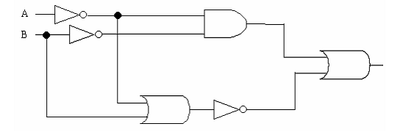
i) Write down the expression for the circuit
ii) Generate a Truth Table for the above circuit.
11/03/21
Computer Org & Arch

Slide 25
  1. AB + A.B
  2.A(AB+A B)
11/03/21
Computer Org & Arch

Slide 26
Construct truth tables for each of the following expressions and draw logic circuits for:.
:
    1.AB + A.B
    2.A (CB+AB)
    3.C(A+B)+AB
    4. Construct a truth table for this expression AB + ((A + B) . AC))
11/03/21
Computer Org & Arch

Slide 27

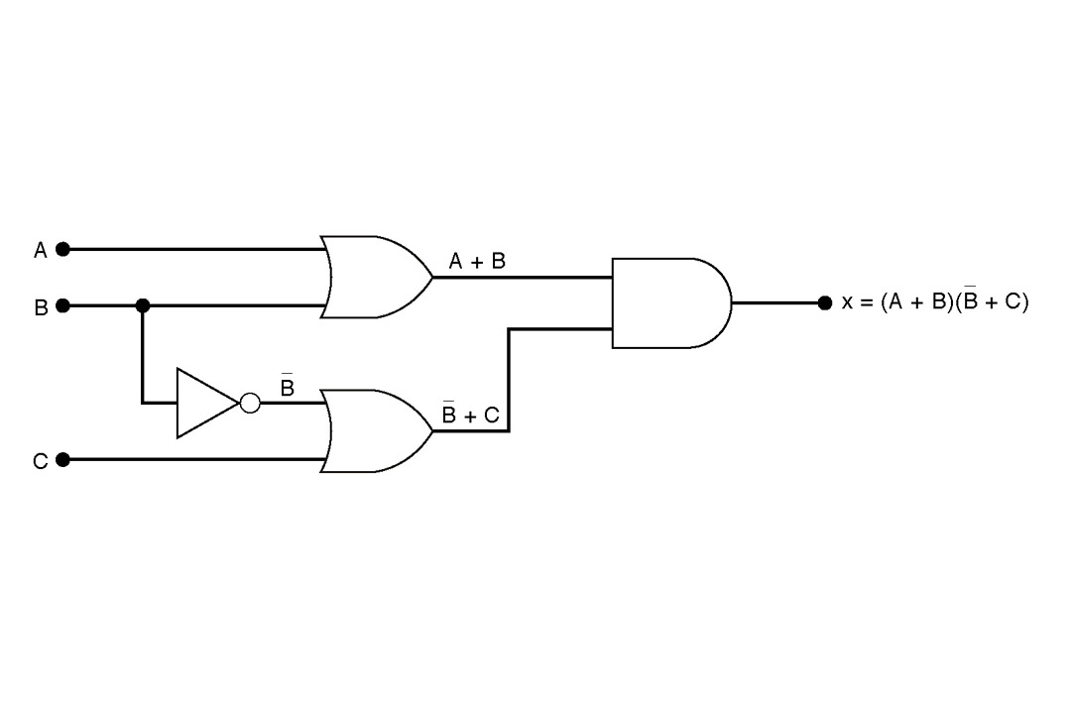
Example
Draw the circuit diagram to implement the expression

Slide 28

Review Question
Draw the circuit diagram that implements the expression
    Using gates having no more than three inputs.

Slide 29

Example
Implement the logic circuit that has the expression
using only NOR and NAND gates

Slide 30
